Slide 1
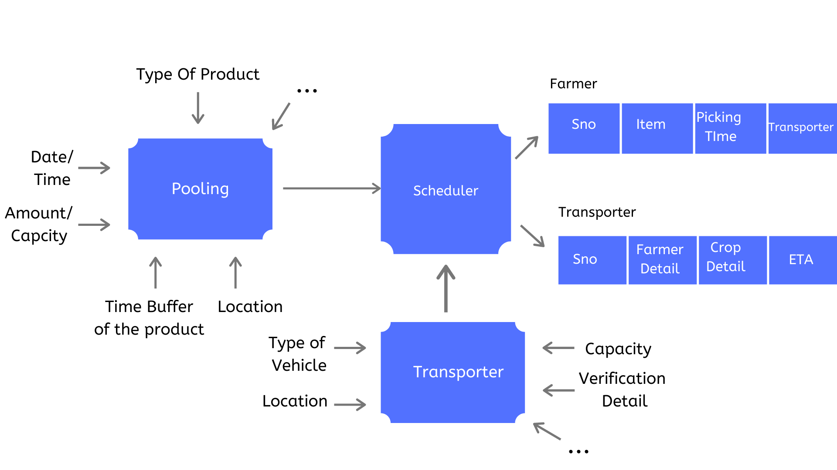
Idea/Approach Details
Approach Details
Ministry/ Organization name: Department Of Science and Technology Problem Statement : Mobile App for sharing or pooling of transport for agricultural produce to market
Team Name : Revenger’s Team Leader Name : Ajinkya Taranekar PSID: PR424
Abstract:-
For the scope of this project, the plausible features to implement in order to what is available in the market are:
A scheduler will generate an optimised chart based on input, which will bring profit both to the transporter and reduce the cost of transportation.
ETA -Estimated Time OF Arrival

Slide 2
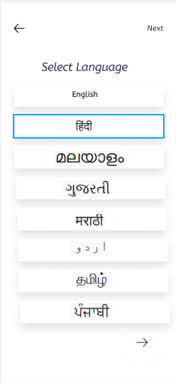
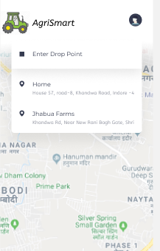
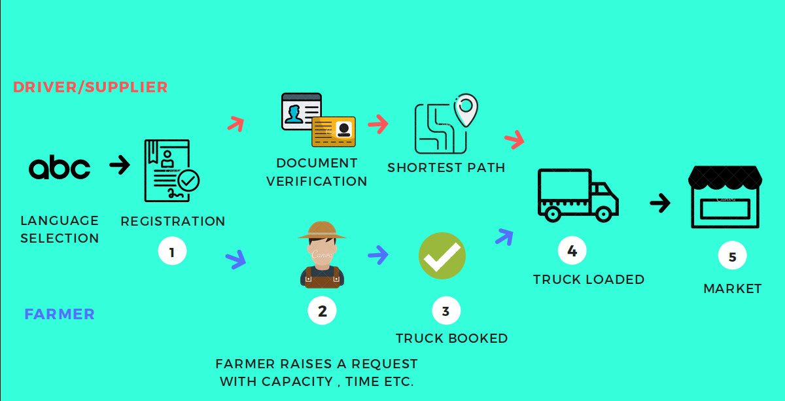
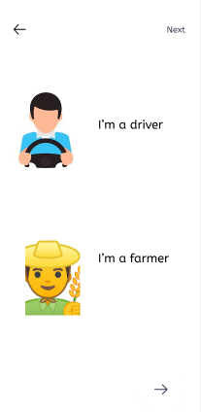
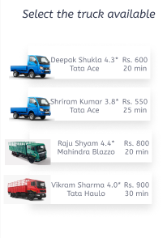
App Flow

Slide 3
Use case:-
The App will provide a platform for interaction of both farmer and transporter. Such that, both parties will get more profit. Along, with this the truck pooling will ensure the pollution check and minimum fuel utilisation.
Solution:-
We are providing the solution for both farmer and driver as:-
Online mode:- Registration and Booking can be done through app.
Simplified UI :-As the stakeholders are farmers and transporters, we have simplified UI to such an extent,so that anyone can easily understand and navigate through app.
Sorting of goods:- Fruits/Vegetables... will get higher priority for delivery.
According to the type of good, the Scheduler will schedule the chart for the transporter.
Routing :- Most appropriate route will be found using TomTom Routing API.
Tracking :- Done using optimised solution of GPS positioning.
Technology Stack:-
 | Frontend | Backend-
1 | IDE – VS Code | IDE - VS Code
2 | Build System – Gradle | Database – MongoDB
3 | UI Designing – Figma | TextLocal API (for SMS)
4 | Framework - React Native | Node JS + Express
Dependencies:-
TomTom Developers API :- https://developer.tomtom.com/
MongoDB - https://www.mongodb.com/cloud/atlas
Text Local API - https://www.textlocal.in/

